Slide 1
COMP6236
Oli Bills
ofb@ecs.soton.ac.uk

Slide 2
How much do I need to write?
Rough guideline is ~1200 words
Although you can go up to 2000 words
That’s only around 120-200 words per sample
The key thing is you don’t have to write loads
Just write the interesting stuff!
What did you find, why was it interesting, how did you find it
Some will be longer than others – that’s fine!
Was it suspicious/legitimate, and why?

Slide 3
Example Answers
sample11.exe
Static analysis: Looking at the version information, sample1.exe claimed to be Notepad by Microsoft, but was not digitally signed. Using Detect it Easy, it was obvious sample11.exe was packed with UPX, which was then unpacked. The application had no digital signature nor version information, which was suspicious. Examining the imports, it used Ntdll.dll and WSock32.dll indicating low-level behaviour and network behaviour. PEStudio also highlighted it contained anti-debugging code and expected to be ran as an administrator, further indicating suspicious activity. Looking at the strings, it contained a list of common antivirus and system executables, which again was suspicious. Using Resource Hacker, there were no resources contained inside, which was suspicious. Confirming suspicions with IDA, it appears to attempt to terminate and replace these executables with a copy of itself.
sample12.exe
Static analysis: sample12.exe contained no version information or digital certificate. It was packed with ASPack, which is potentially suspicious, and it was not possible to unpack the contained executable. As it was packed, it was not possible to examine the imports and strings. Based on the icon and lack of information and the fact it is packed, it is likely to be suspicious, but not possible to confirm with static analysis.

Slide 4
Dynamic Analysis
Dynamic analysis is all about what we can learn from the program while it is running
We can do this by examining the program state throughout execution
Approach for verifying software (including finding defects) by executing software on specific inputs & checking results
Functional testing, web application scanners, fuzz testing, etc.
Detection of vulnerabilities is integrated into the actual program’s execution

Slide 5
What can you find?
Runtime error detection
Subtle defects and vulnerabilities
Memory issues
Memory leaks
Input/output validation issues
Find the results of non-expected inputs
Pointer arithmetic errors
Response time issues
Functional issues
Performance

Slide 6
What can’t you find?
Anything off the runtime path
Input dependent

Slide 7
Common Dynamic Analysis
Coverage
Performance
Memory Usage
Security properties
Concurrency errors
Violation of rules
Invariant detection
Run the program, collect the information, analyse it

Slide 8
Code Instrumentation
A technique that inserts extra code into a program to observe its runtime behavior
The extra code is called instrumentation code
It inserts calls to analysis code when an instruction is executed
Analysis code collects data about the execution of an instruction or about its behavior
The code can be inserted in the source code or in the binary code

Slide 9
Instrumentation approaches
Source instrumentation
Instrument source programs
Binary instrumentation
Instrument executables directly
Advantages for binary instrumentation
Language independent
No need to recompile the code
All code is naturally covered

Slide 10
Code Instrumentation: Source Code
#include <stdio.h>
int addnum(int a, int b)
{
int sum;
sum= a+b;
return sum;
}
int main()
{
int total;
int x,y;
x = 4;
y = 7;
total = addnum(x,y);
printf("total %d\n”, total);
}

Slide 11
Code Instrumentation: Source Code
include <stdio.h>
int addnum(int a, int b)
{
int sum;
printf("Debug: Entering addnum %s %d\n",
__FILE__, __LINE__);
sum = a+b;
printf("Debug: Leaving addnum %s %d\n”,
__FILE__, __LINE__);
return sum;
}

Slide 12
Code Instrumentation: Source Code
include <stdio.h>
int addnum(int a, int b)
{
int sum;
#ifdef INSTDEBUG
printf("Debug: Entering addnum %s %d\n”,__FILE__, __LINE__);
printf("Debug: a = %d\n”, a);
printf("Debug: b = %d\n”, b);
#endif
sum = a+b;
#ifdef INSTDEBUG
printf("Debug: sum = %d\n”, sum);
printf("Debug: Leaving addnum %s %d\n”,__FILE__, __LINE__);
#endif
return sum;
}

Slide 13
Compile-time Instrumentation
Source
Code
Instrumentation
Code
(Library)
Compiler
Compile Time
Runtime
Instrumented
Executable Code

Slide 14
Compile-time instrumentation tools
gprof
provides program profiling
gcov
provides coverage analysis
dmalloc
provides drop in replacement for the system's malloc, realloc, calloc, free and other memory management routines to enable runtime tracking of memory-leaks, out-of-bounds writes, and other capabilities

Slide 15
Runtime-Instrumentation
Instrumentation
Code
Virtual Machine
Binary Code
Code
Cache
JIT Compiler
Dispatcher

Slide 16

Valgrind
It is a tool suite that provides a number of debugging and profiling tools
The most popular of these tools is called Memcheck
detects many memory-related errors that are common in C and C++ programs and that can lead to crashes and unpredictable behaviour

Slide 17
Installing Valgrind
Download Valgrind from http://valgrind.org/downloads/
“cd” to the directory containing the package’s source code
Type “./configure”
Type “make” to compile the package
Type “make install” to install the program

Slide 18
Run Valgrind
Prepare the program
Compile the program with the -g debug option
e.g gcc -g –O0 sourcefile.c -o binarycodename
Run valgrind
Type valgrind –leak-check=yes ./binarycodename arg1 arg2..argn

Slide 19
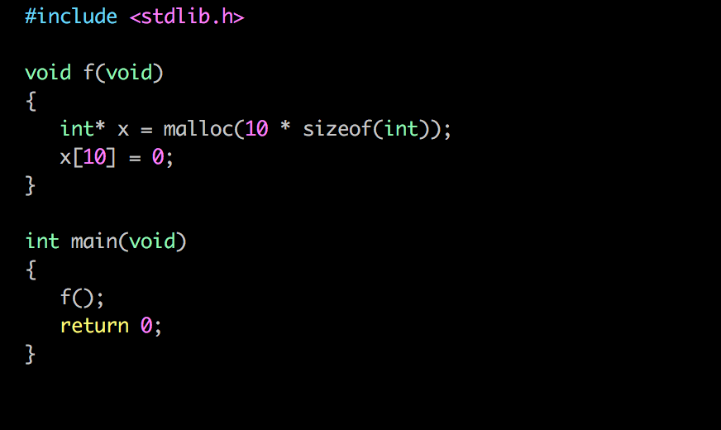
Let’s take a look at an example

Slide 20
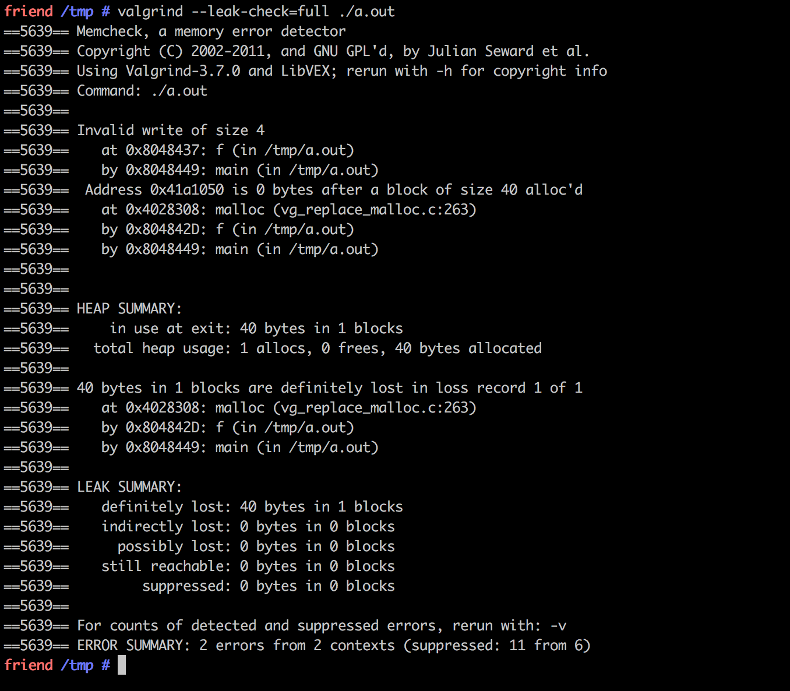
Let’s take a look at an example

Slide 21
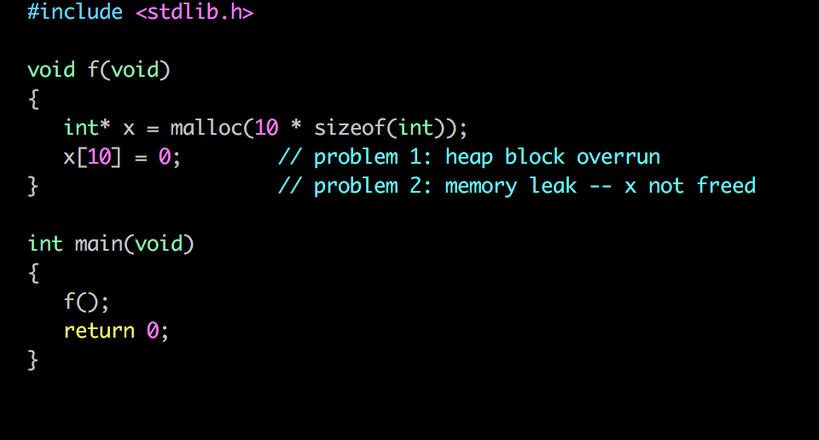
Let’s take a look at an example
We found two vulnerabilities
Over-running the heap block
Memory leak from non-freed malloced memory

Slide 22

Pin
Pin is a dynamic binary instrumentation framework developed by Intel Corp
It lets you build program analysis tools called Pintools for Windows and Linux platforms
Pintools are written in C/C++
You can use these Pintools to monitor and record the behavior of a program while it’s running

Slide 23
Pin
They have 3 main components
Instrumentation
Enable the insertion of analysis routines
Analysis
Performing the analysis itself
Callback routines
Called when specific conditions are met

Slide 24
An Example of Pintool

Slide 25
Advantages of dynamic analysis
No false positives or negatives on a given run
An error detection occurs right at the moment of its occurrence
Do not need source code
You can also test proprietary code
Clear which path was taken
Can be used on live code
Particularly useful for security!

Slide 26
Disadvantages of dynamic analysis
Detect vulnerabilities only on execution path defined by the concrete input data
Significant computational resources are required to perform the analysis
One execution path can be checked at each particular moment
It is more difficult to track back a vulnerability to its exact location in the code

Slide 27
Other types of dynamic tools
Network scanners
Network sniffers
Network vulnerability scanners
Web application scanners
Intrusion detection systems
Firewalls
Debuggers

Slide 28
Comparison
Static analysis
Dynamic analysis
Analyze code without executing it.
Systematically follow an abstraction.
Find bugs/enforce specifications/prove correctness.
Often correctness/security related.
Analyze specific executions.
Instrument program, or use a special interpreter.
Abstract parts of the trace.
Find bugs/enforce stronger specifications/debugging/profiling.
Often memory/performance/concurrency/security related.

Slide 29
Malware Dynamic Analysis
Observing the malware while it is running
Monitoring what it does
System calls
File reads/writes
Registry reads/writes
Network activity
Process activity
Requires a safe sandboxed environment
The machine will be infected!
The malware may not behave as we want
If it detects it’s being watched…

Slide 30
A safe environment
A virtual machine running your target OS
Install your tools and set up
Use snapshots
Including one before you do anything
You can go backwards and forwards and observe
Learn your environment before you start
Know what was there at the beginning!

Slide 31
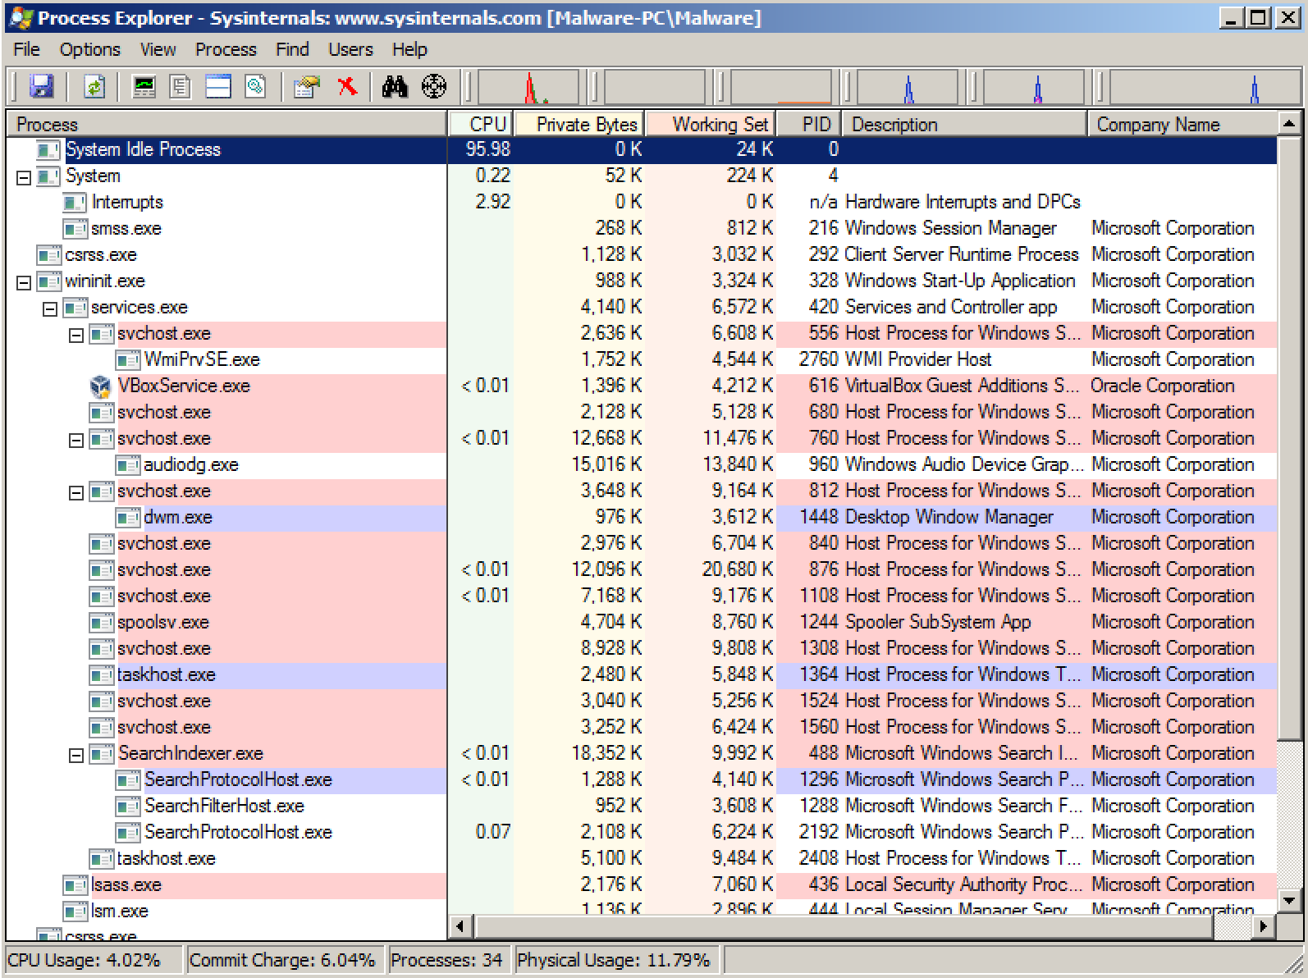
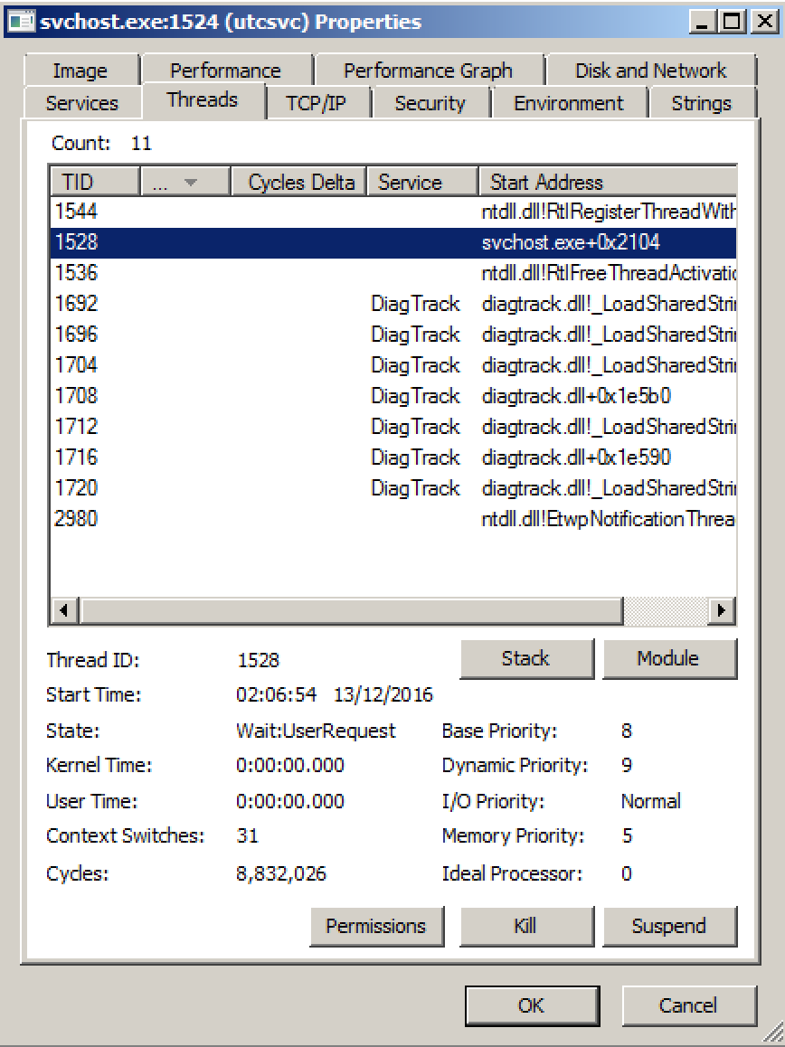
Process Explorer
Run procexp.exe
Show all the current processes running on the system
Show processes starting and terminating
Allow inspection of processes
Strings
Threads
TCP connections
Identify file handles
Allows manipulation of processes
Kill/Suspend
Shows children and parent process relationships
Can show where processes have come from (autostarts)
Can show packed processes (more likely to be dodgy)
Can submit process images to VirusTotal for checking

Slide 32
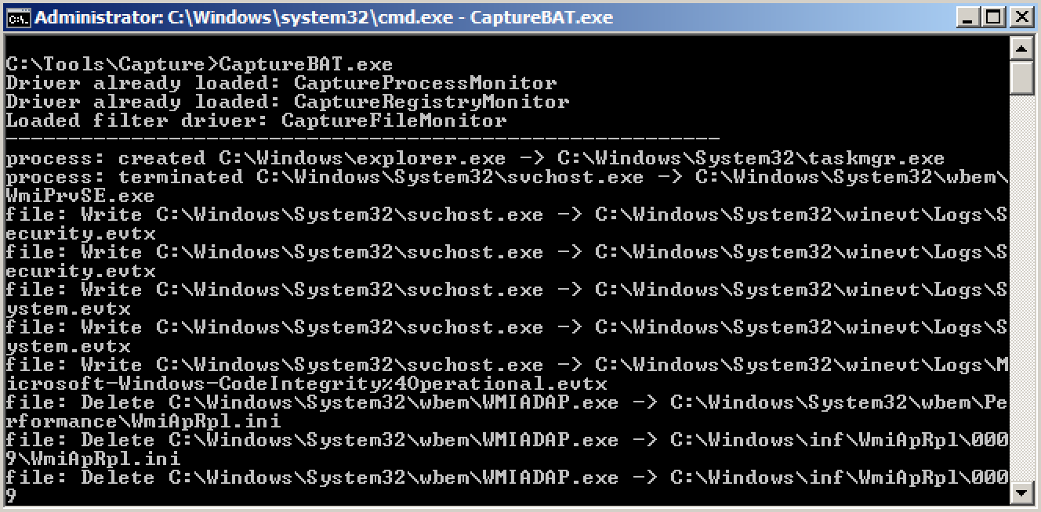
CaptureBAT
Run CaptureBat.exe
Traces every call to system functions
Let’s you see what’s happening when it happens!

Slide 33
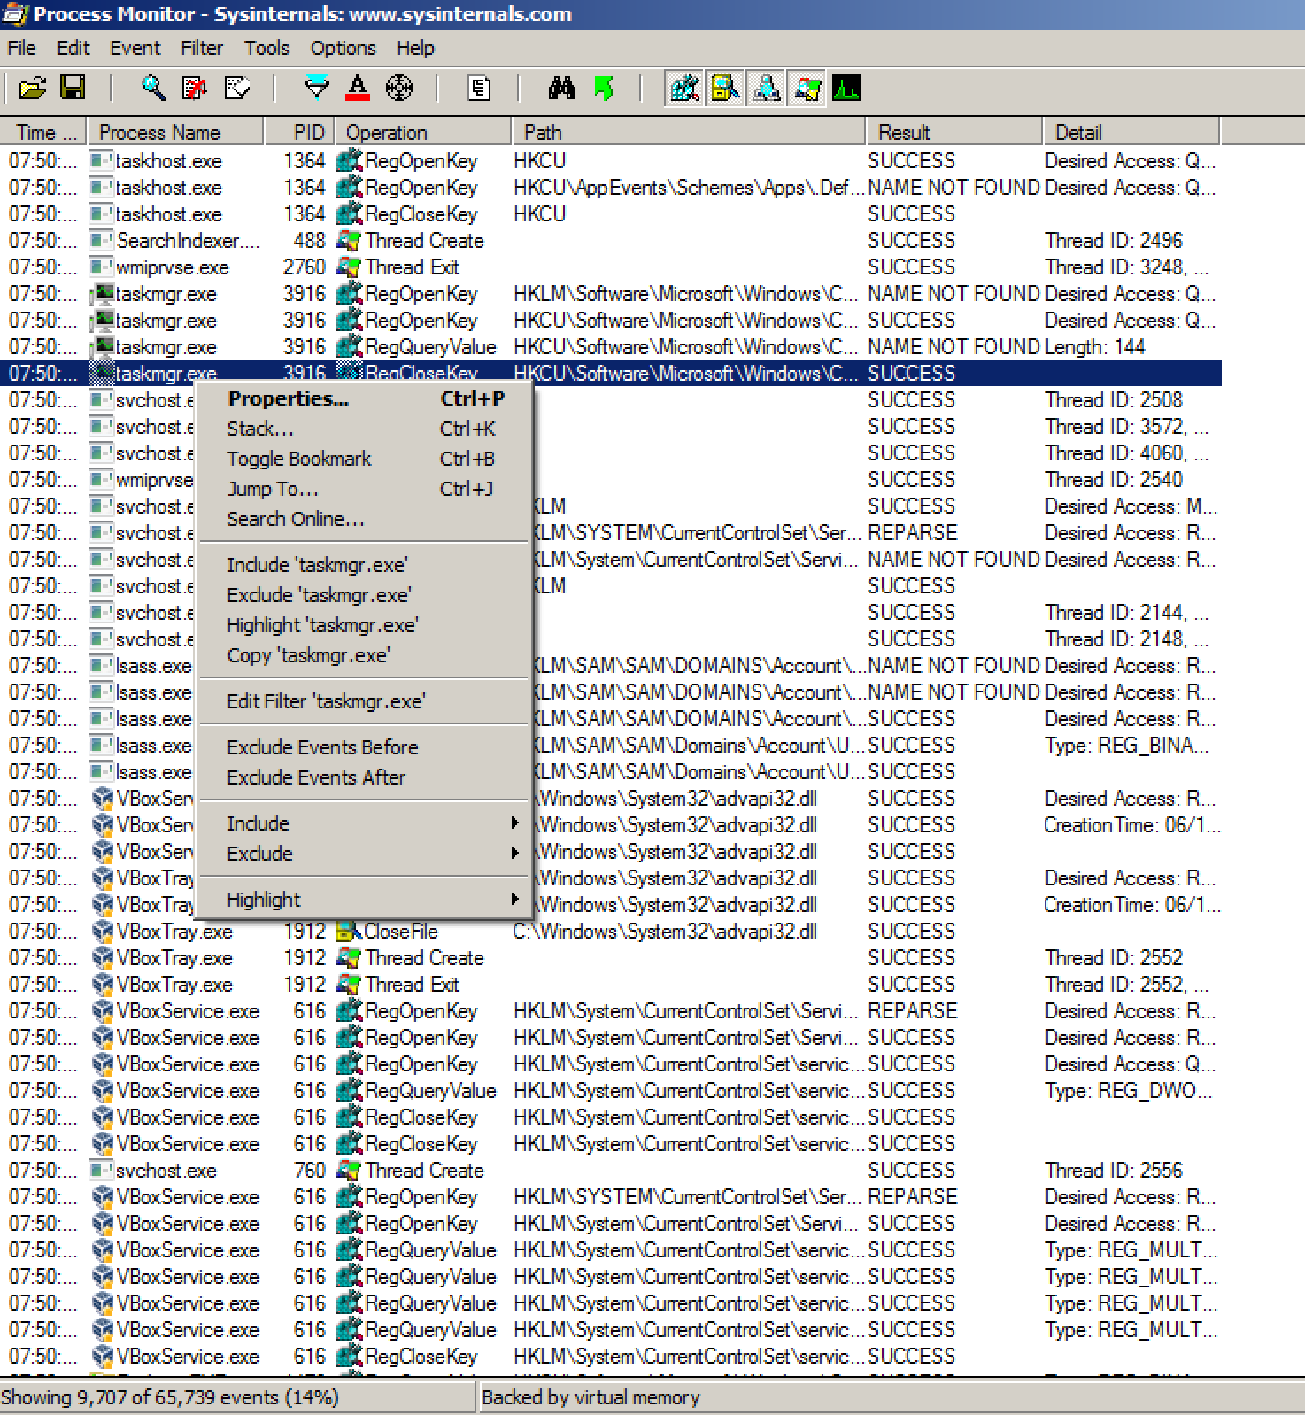
Process Monitor
Run procmon.exe
More advanced than Capture BAT
Lets you see everything that’s happening
Registry
Files
Networking
Processes
But you’ll be overloaded
The key, is filtering!

Slide 34
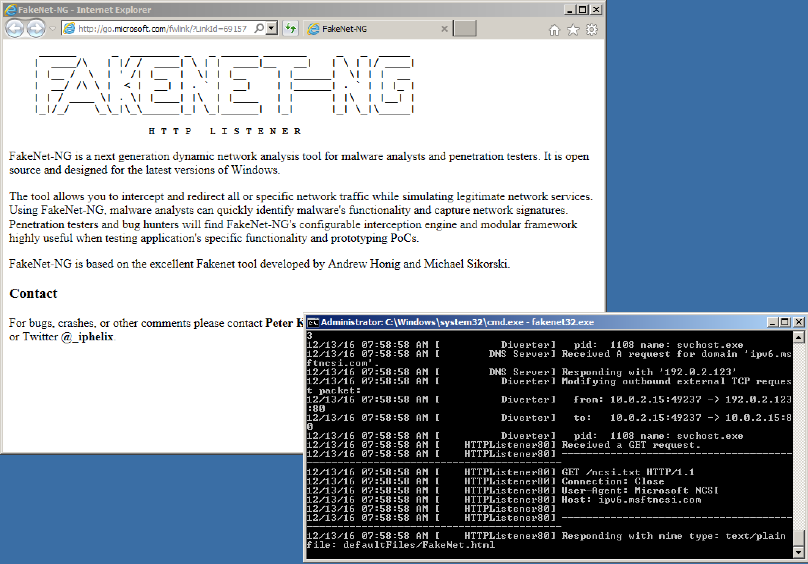
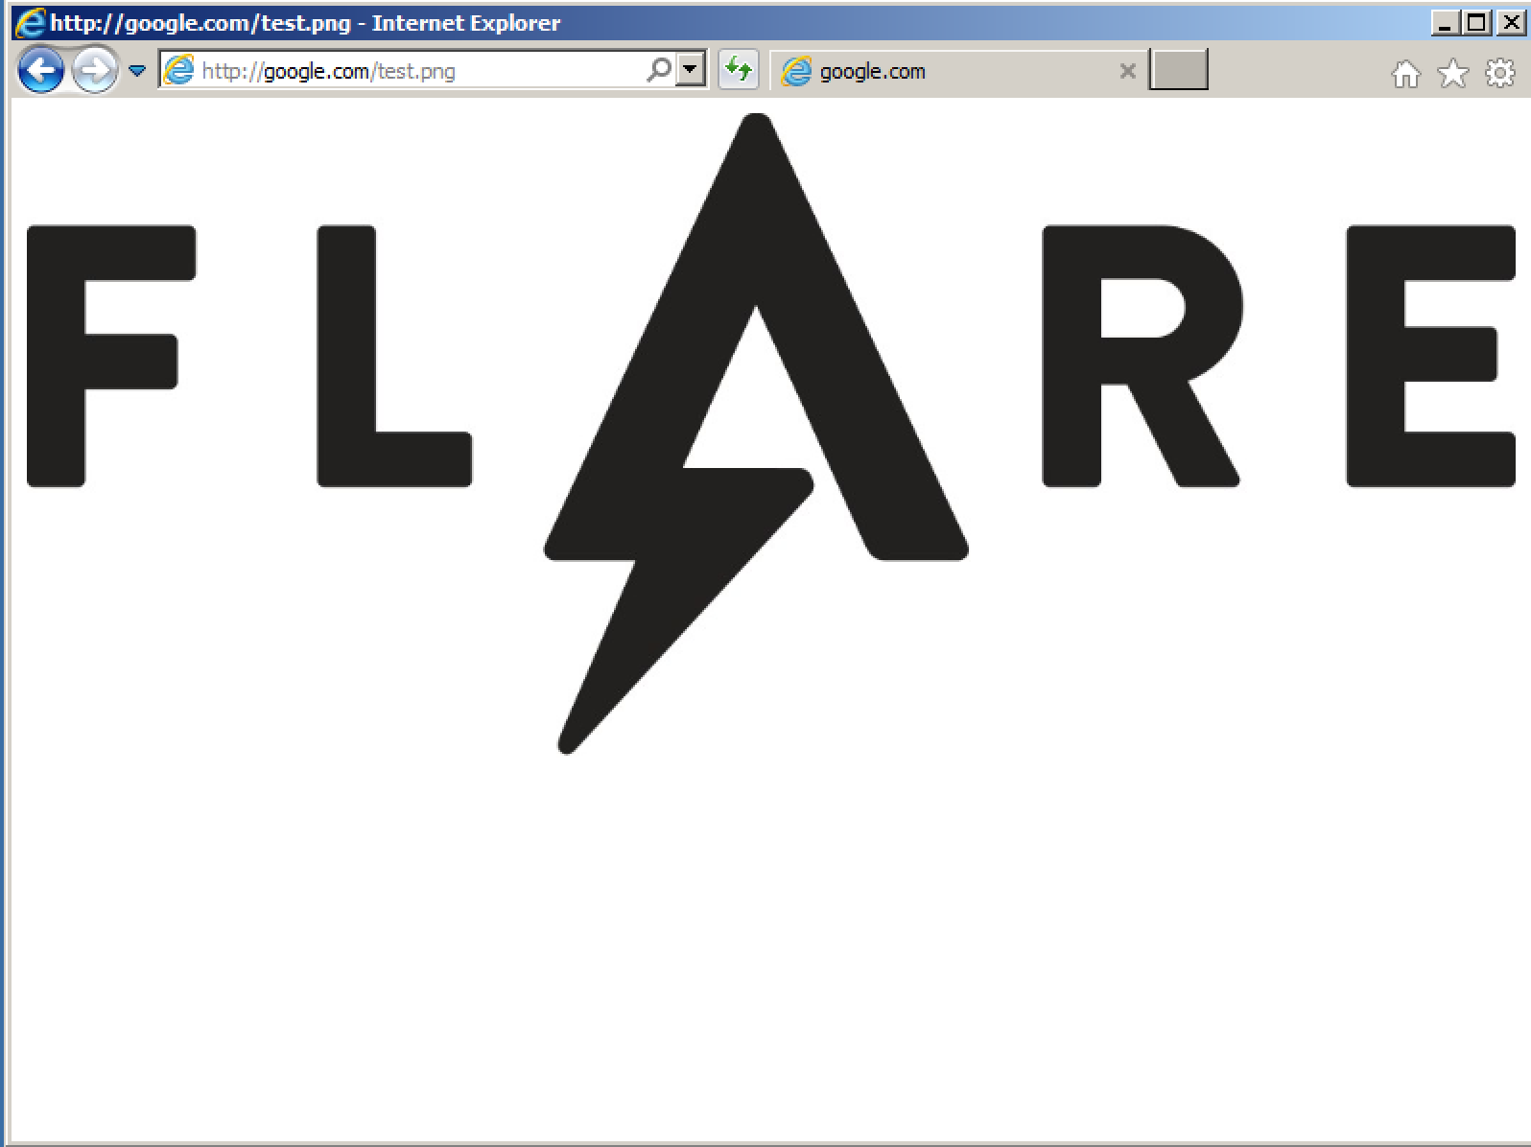
FakeNet (and INetSim)
Redirect network requests back to your local or analysis machine by hijacking DNS
Responds with false replies to requests
HTTP requests – sends files back, with the correct type
Shows you every request that is coming in
Listens on every port

Slide 35
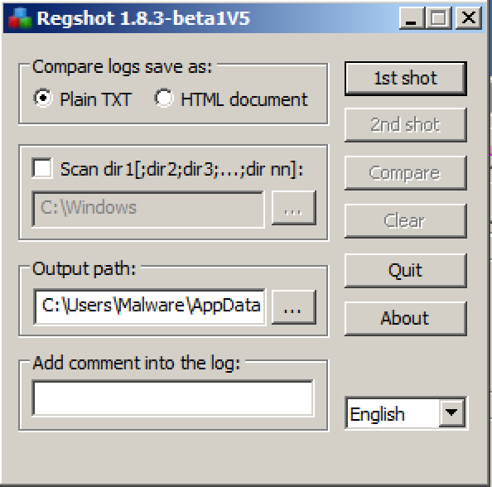
Regshot
Comparison tool
Take a snapshot of the registry and folders
Run the malware
Take another snapshot of the registry and folders
Regshot lets you see what has changed!

Slide 36
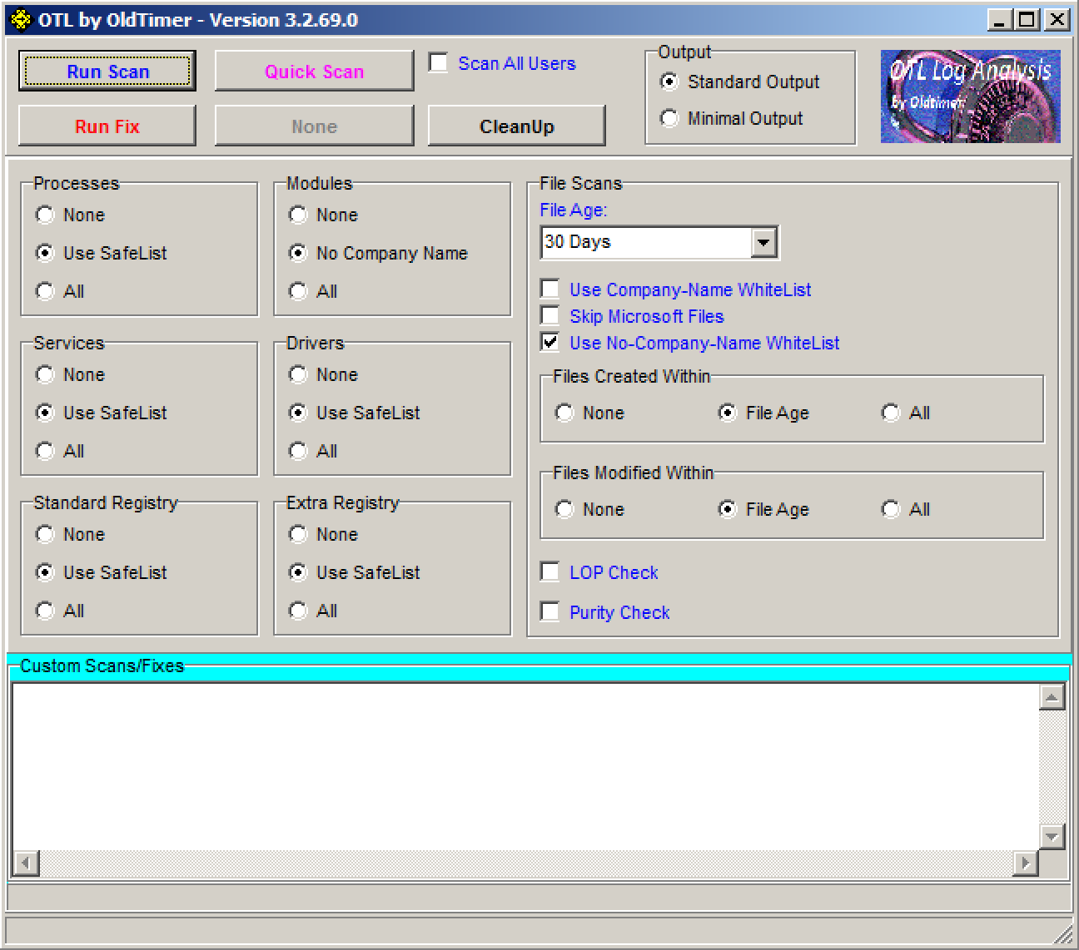
OTL
Inspects the computer and common places where malware starts up
Inspects other places that malware attack (e.g. browser extensions)
Looks at recently modified or changed files
Looks at anything else that’s out of place
Generates a log file that you can take a look at or share
Good for remote analysis
Ability to then tell it what to do and it’ll do it’s best to remove
Comparison: Run before and after infection - what’s changed?

Slide 37
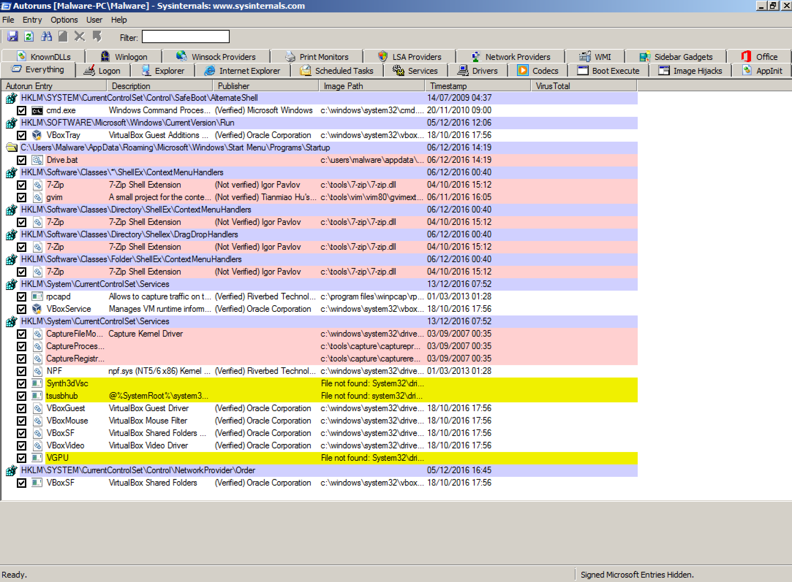
Autoruns
Works well combined with Process Explorer
Investigates all common locations where malware can try to start up automatically
Can hide signed and verified images
Can hide Microsoft and Windows images
Easy to spot and narrow down anything that shouldn’t be there
Particularly things starting up in strange ways
Let’s you temporarily disable or remove autostarts
Also linked up to virustotal.com

Slide 38
GMER
One of the best Rootkit detection tools
Looks at the way the system calls differ from what they should be returning
How is the registry different on disk vs. different to reading it through the registry functions?
How is the disk different reading directly form disk vs. reading it through file functions?
Are there any unexpected or odd hooks into the kernel, functions overridden?
Are there any unexpected access problems when trying to scan?
Any discrepancies are likely to be rootkit behaviour
Quick sign of detecting whether you are infected with a Rootkit! But it won’t help you remove it

Slide 39
Wireshark
Lets you monitor network traffic
What is being sent and received
Wireshark decodes and helps you see the types of traffic and decodes the payloads
But you can’t see what is happening in each application
Combine with TCP View

Slide 40
The questions to ask
What files are manipulated?
What in the registry is manipulated?
How does the malware persist?
What processes does it create?
What processes does it manipulate?
Does it try to communicate over the network?
Does it resist being studied?

Slide 41
Advanced Dynamic Analysis
Firing up the debugger
Walking through the malware as it runs
A few options
OllyDbg
Was good, but rather unmaintained now…
You’ll see this often
Mainly survives because of plugins
X64dbg
Compatible with OllyDbg plugins
Most people are switching to these days
Radare2
Command-line based but very powerful
All set up and ready to go!
We will take a look at these later!

